Slide 1
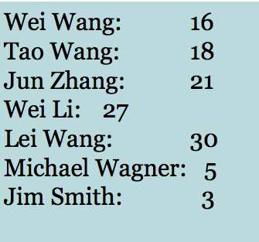
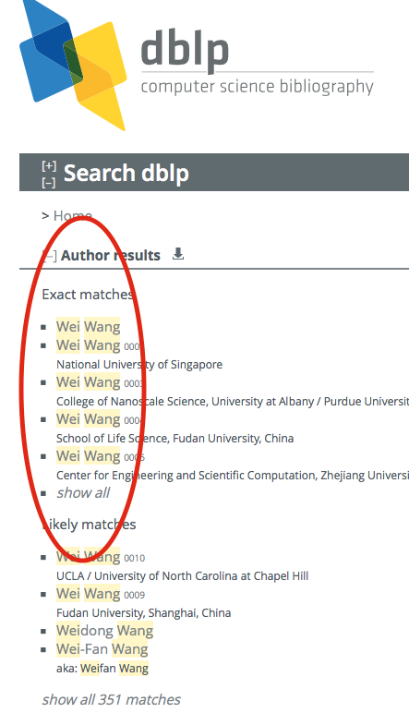
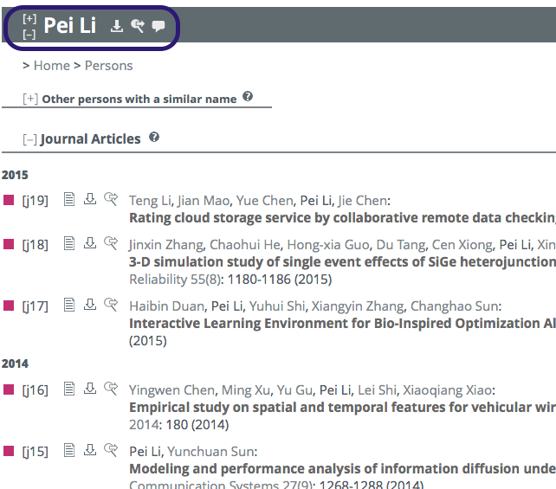
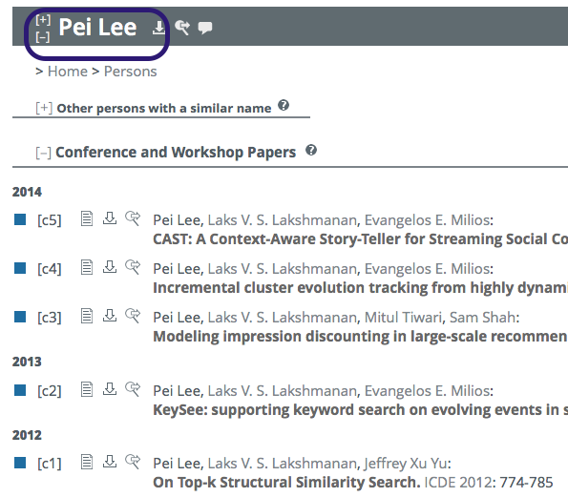
DQ Problems in DBLP
Polyseme: 10+ different “Wei Wang”
Synonyms: “Pei Lee” and “Pei Li”

Slide 2

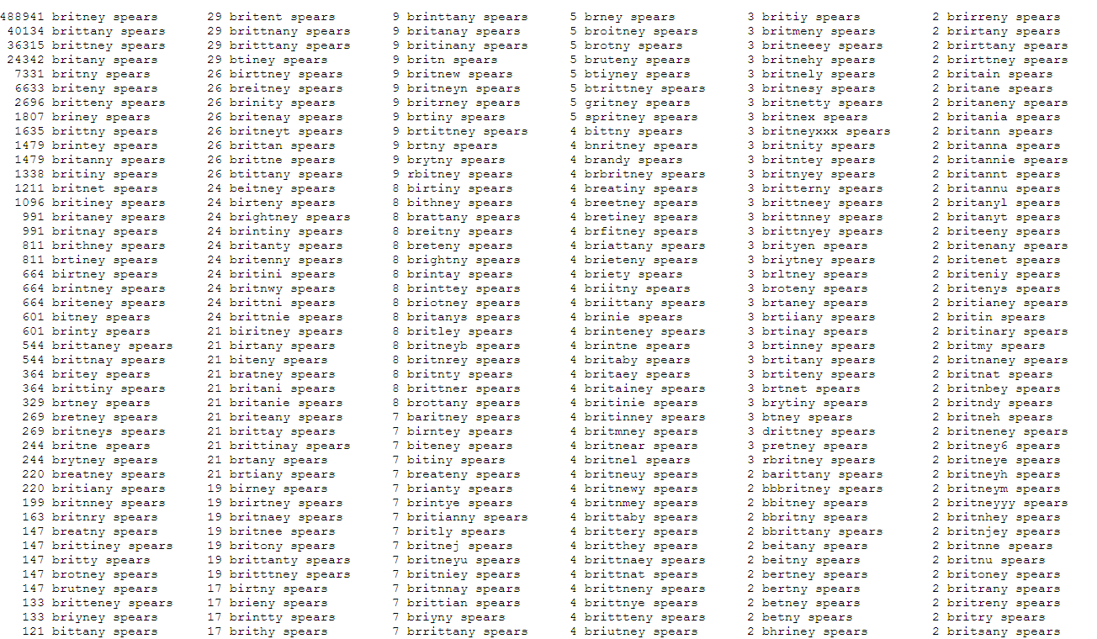
Difficult Names in Google Search

Slide 3
More Examples in Real Life
Retail company found over 1m records contained home tel number of “000000000” and addresses containing flight numbers
Insurance company found customer records with 99/99/99 in creation date field of policy
Car rental company discovered duplicate agreement numbers in their data warehouse
Healthcare company found 9 different values in gender field
Food/Beverage retail chain found the same product was their No 1 and No 2 best sellers across their business
Statistics with Enterprises:
25% of Fortune 1000 companies work with inaccurate data, which costs businesses an estimated $611 billion dollars a year (Gartner 2007)
Data Quality $1 billion in 2008, with $556 million for tools (Forrester Research)

Slide 4
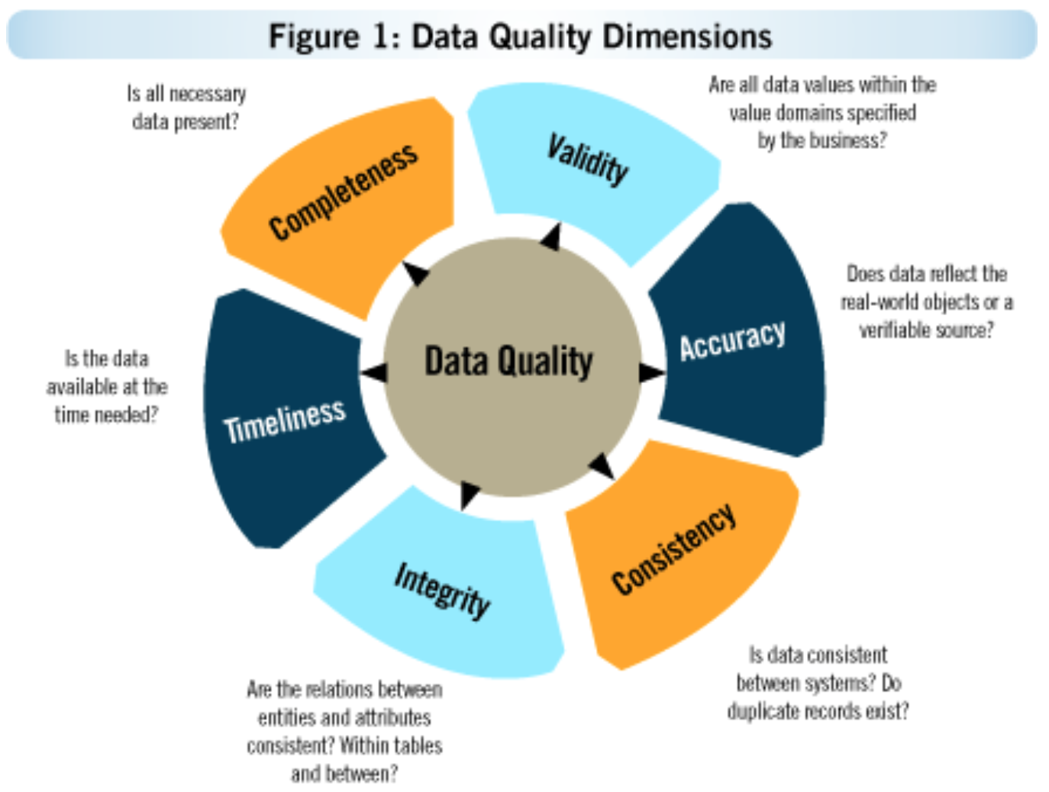
Six DQ Dimensions
Accuracy:
e.g., “Zhixu Li” -> “Zhuxi Lee”
Consistency:
e.g., “US” vs. “The United States of America”
Integrity:
no referential foreign keys
Timeliness (Obsolete):
e.g., Dead, Name changed
Completeness:
e.g., Missing privacy information
Validity:
e.g., human age = 300?
salary = -10,000?

Slide 5
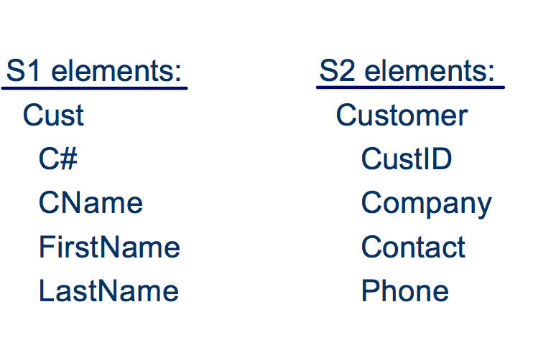
Schema Mapping
A Matching Example

Slide 6
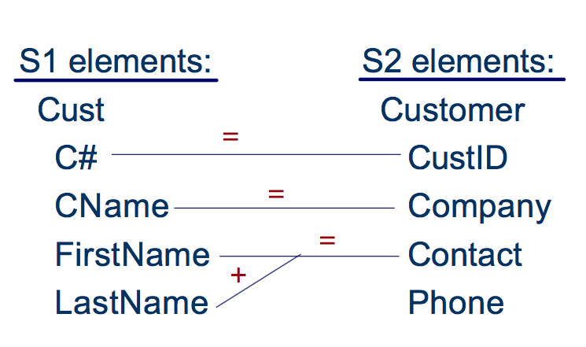
Schema Mapping
A Matching Example

Slide 7
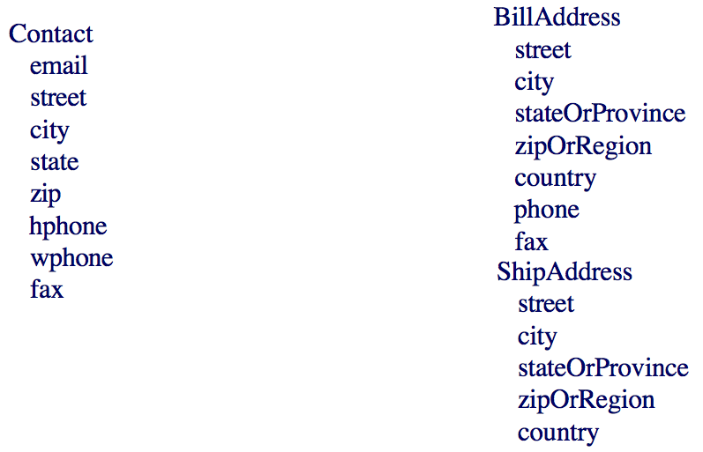
Schema Mapping
What Makes Matching Complicated?

Slide 8
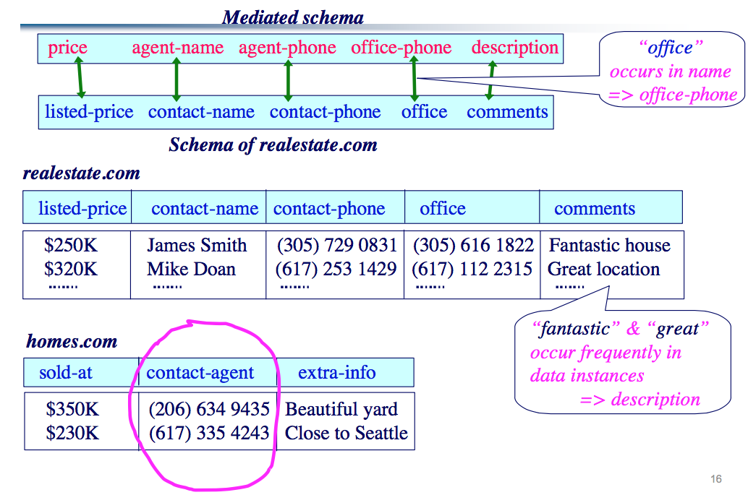
Schema Mapping
Example Matching Problem

Slide 9
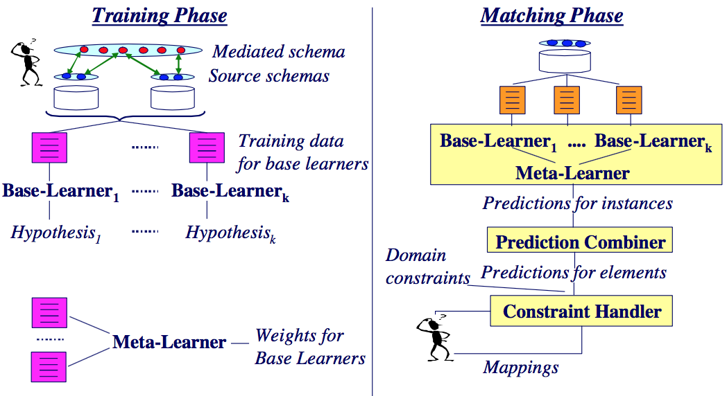
Schema Mapping
The LSD Architecture

Slide 10
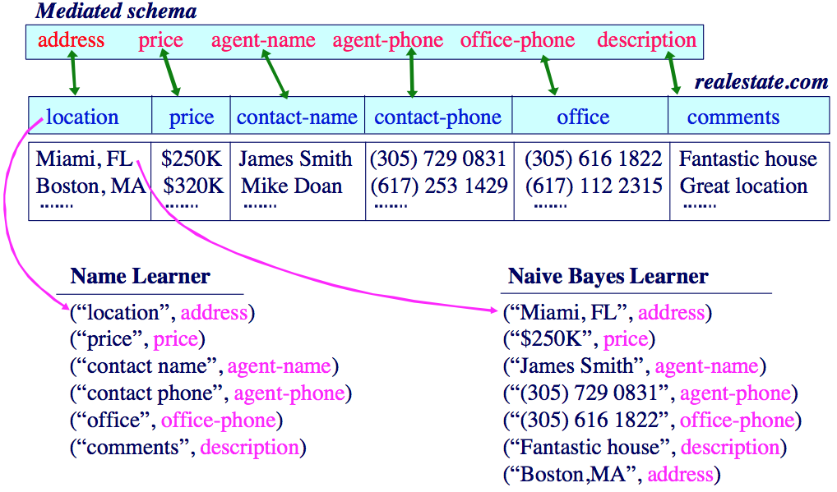
Schema Mapping
Training the Base Learners

Slide 11
Data Cleaning
Problem of Textual Data Cleaning
IDENTIFY and CORRECT erroneous data in textual relational tables.
Name | University | City | Country
San Zhang | Soochow Uni. | Soochow | China
Si Li | Soochow Uni. | Hefei | China
Er Wang | Soochow Uni. | New York | USA

Slide 12
Data Cleaning
Traditional Methods
Quality Rules/Constraints:
FDs/CFDs: e.g., “(University -> City, 0.98)”
Identify inconsistent data in Conflicts, choose a minimum change
User-Defined Quality Rules: e.g., change all capital into lowercase
Inconsistency Data != Erroneous Data
Minimum Change != Correct Change
Machine Learning Models:
Learn models with the existing data for data cleaning
Can NOT guarantee correctness
Crowdsourcing:
Let the Crowd help clean the data: can reach a much higher precision/recall
e.g., find errors, fill blanks, make choices between conflicts
Expensive!
Hybrid: Rule-based+Crowd, Model-based+Crowd, ...

